Slide 1

Universal Application Development on Windows Platform for Beginners Module 6. Files and data storage
Dmitry Soshnikov dmitryso@microsoft.com | twitter.com/shwars | blog.soshnikov.com Microsoft

Slide 2
Agenda
File Management
Read/Write files
Folders
File Open/Save pickers
Known Folders

Slide 3
Where are files?

Slide 4


Locations where apps can access data
Credential Lockers
Cloud
File system
Publishers Shared Folder
Temp
App data Folders
Roaming
File Open/Save picker APIs
App data Folders
r/w
r/w
Local
App Data Folders
r/w
r/w
App
App Package Folder
r/o
r/w
Known Folders
Pictures Videos Music
Removable
Storage (SD Card)

Slide 5





Package and App Data Folders
App Package Folder
Creates root folder to App
Package Manager
Install
DB
Files (r/o)
App Data Folder
App
Create/Manages
Files and Settings
Storage API
Local or Roaming Settings File
DB
App Files
Database files
Notes:
Package Manager устанавливает все файлы приложения в папку «App package Folder»
Приложение имеет доступ «Read-only»
Приложение сохраняет данные в локальной папке «Local Folder»
Настройки и свойства в приложение в settings dictionaries
Данные в файлах
Структурированные данные в файлах базы данных

Slide 6

Directly Accessible R/W Data Storage
Windows.Storage.ApplicationData
Windows.Security. Credentials
Roaming
Local
Temp
Publisher Cache
PasswordVault
Folder
Folder
Folder
Folder
Folder
Other devices can access what you put in here
Store local data here for use by your application
Use for temporary storage
Shared storage for apps from same publisher
Credential Locker
Use for secure storage of PasswordCred-ential objects
Data roamed cross-device

Slide 7
Different Methods For Addressing Storage Locations
Тип файла/ API | Папка установки | Папка данных приложения | Пример
File access using Windows.Storage API via URIs | ms-appx:/// | ms-appdata:///local/ ms-appdata:///roaming/ ms-appdata:///temp/ | var file = await Windows.StorageFile. GetFileFromApplicationUriAsync( new Uri("ms-appdata:///local/AppConfig.xml"));
File access using Windows.Storage API via StorageFolder references | Windows. ApplicationModel.Package.Current. InstalledLocation | Windows.Storage. ApplicationData. Current .LocalFolder / .RoamingFolder / .TempFolder | var localFolder = Windows.Storage.ApplicationData.Current.LocalFolder; Windows.Storage.StorageFile storageFile = await localFolder.GetFileAsync("CaptainsLog.store");

Slide 8
Basic Data Storage

Slide 9
Writing a complete folder
private async void writeTextToLocalStorageFile(string filename, string text) { StorageFolder fold = Windows.Storage.ApplicationData.Current.LocalFolder; StorageFile file = await fold.CreateFileAsync(filename, CreationCollisionOption.ReplaceExisting); await FileIO.WriteTextAsync(file, text); }
This method will write text to a file

Slide 10
Reading a complete file
private async Task<string> readTextFromLocalStorage(string filename) { var fold = Windows.Storage.ApplicationData.Current.LocalFolder; StorageFile file = await fold.GetFileAsync(filename); string result = await FileIO.ReadTextAsync(file); return result; }
This method will read contents of a file into a string

Slide 11
Credential Locker
Encrypted, roamed storage for PasswordCredential objects
void SaveCredential(string username, string password) { PasswordVault vault = new PasswordVault(); PasswordCredential cred = new PasswordCredential("MyAppResource", username, password); vault.Add(cred); } IReadOnlyList<PasswordCredential> RetrieveCredential(string resource) { PasswordVault vault = new PasswordVault(); return vault.FindAllByResource(resource); }

Slide 12
Publisher’s shared storage folder
Apps from the same publisher may share files and settings
A subfolder is required.
Edit app manifest to add.
<Package> <Extensions>
<Extension Category="windows.publisherCacheFolder"> <PublisherCacheFolder> <Folder Name="Folder1"> </PublisherCacheFolder> </Extension>
</Extensions> </Package>

Slide 13
Known Folders

Slide 14
Accessing User Content
var pictures = await Windows.Storage.KnownFolders.PicturesLibrary.GetFilesAsync();
KnownFolders provides access to:
Pictures, Videos, Music
Notes:
KnownFolders позволяют получить прямой доступ к папкам с файлами пользователей (не забудьте указать это в возможностях Capabilities)

Slide 15
KnownFolders
KnownFolders is an API which simplifies the view the developer has of accessible user data on the phone
Files in KnownFolders are visible to all apps (that have registered the proper capabilities)
Consider using the FileOpenPicker API as an alternative to allow users to select a file in these folders
Notes:
Вместо того, чтобы искать во всех возможных местах на устройствах для конкретного типа файла, программа может запросить единый список всех файлов Это включает в себя файлы на карте памяти SD (если она установлена ​​) вместе с файлами , сохраненными на устройстве

Slide 16
File Open/Save Pickers

Slide 17
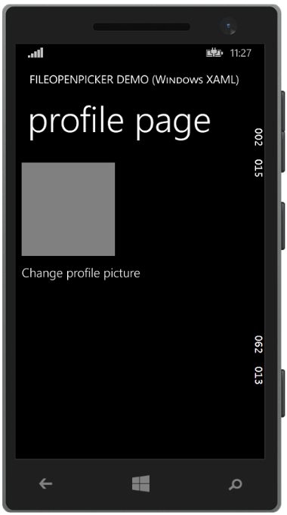
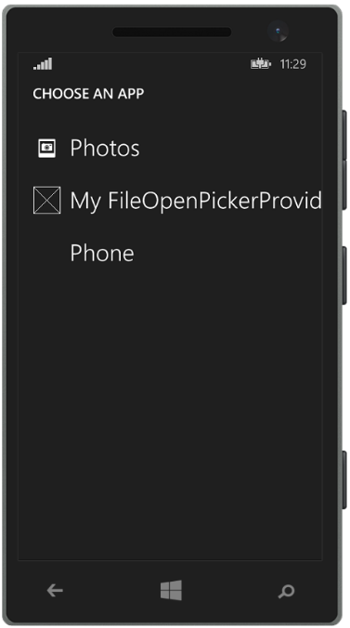
FileOpenPicker/FileSavePicker
Your app
Provider selection

Slide 18
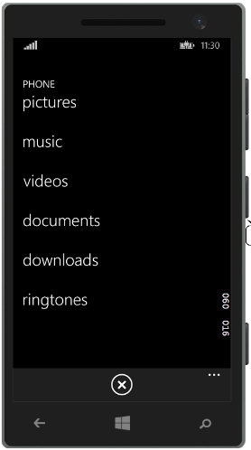
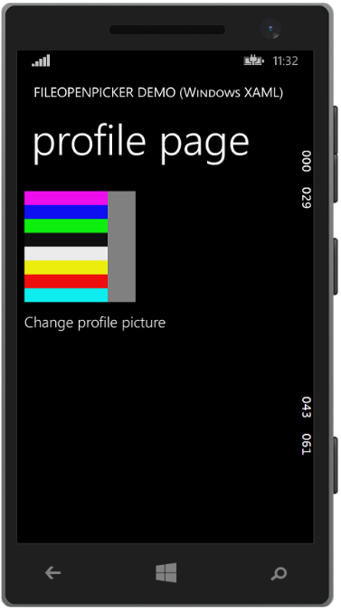
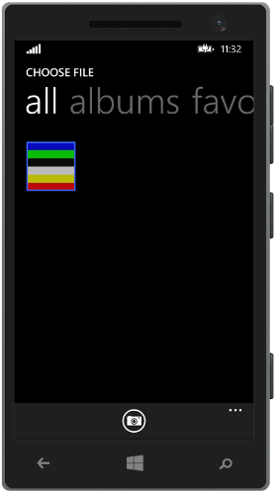

FileOpenPicker/FileSavePicker
Other apps…
Provider UI
Your app

Slide 19
File Open/Save Pickers
Apps shouldn’t care where files come from or go to
Allows an app to access files that are not in the app data folders (e.. cloud, devices, other app)
Support both Open and Save
Notes:
Приложения могут получить доступ к любому типу файлов
Позволяет приложению получить доступ к файлам вне папки с данными приложения Доступ к файлам из библиотек Pictures, Videos без использования KnownFolders API (необходимо прописывать в возможностях)
Сохраняет в облако, на устройство или в приложение

Slide 20
Pick a file
//Create the picker object FileOpenPicker openPicker = new FileOpenPicker(); openPicker.ViewMode = PickerViewMode.Thumbnail; openPicker.SuggestedStartLocation = PickerLocationId.PicturesLibrary; // Users expect to have a filtered view of their folders openPicker.FileTypeFilter.Add(".jpg"); openPicker.FileTypeFilter.Add(".png"); // Open the picker for the user to pick a file StorageFile file = await openPicker.PickSingleFileAsync(); if (file != null) { // Do something with the file... }

Slide 21
Save a file
//Create the picker object FileSavePicker savePicker = new FileSavePicker(); savePicker.SuggestedStartLocation = PickerLocationId.DocumentsLibrary; // Dropdown of file types the user can save the file as savePicker.FileTypeChoices.Add("Plain Text", new List<string>() { ".txt" }); // Default file name if the user does not type one in or select a file to replace savePicker.SuggestedFileName = "New Document"; // Open the picker for the user to select the target file StorageFile file = await openPicker.PickSaveFileAsync(); // Save the content to the file ...

Slide 22
DEMO

Slide 23
Review
File Management
Read/Write files
Folders
File Open/Save pickers
Known Folders
Repo:
https://github.com/evangelism/Win10UWPCourse

Slide 24

Contact
Dmitry Soshnikov
Microsoft
dmitryso@microsoft.com & vk.com/shwars
blogs.msdn.com/sos & blog.soshnikov.com
twitter: @shwars

